Slide 1
Disability Under Siege
Cultural Practices Literature Overview,
Findings and Future Visions
March 31st 2021
Professor Anthony Downey
Birmingham City University

Slide 2
Inclusive Art Practices and Disability-led Organisations
What are the opportunities and barriers to promoting inclusive education through collaborative partnerships between cultural partners and disability-led organisations?

Slide 3
https://disabilityundersiege.org/current-research/
Literature and Practice Review

Slide 4
Literature and Practice Review
Legislation and Visibility
Absence of Coherent and Accessible Government Policies and National Legislation
Lack of visibility of Issues
Widespread cultural stereotyping and social misrepresentation of disability
Cultural Partners and Practices supporting Disability
Absence of sustainable support for disability organisations to engage with art institutions (and vice versa)
No roadmaps for sustainable Practices and Partnerships
Lack of evaluative impact studies and processes for considering the productive relationship between art and disability practices

Slide 5
01 Legislation and Provision
02 Education, Cultural Networks and Disability
02 Education, Cultural Networks and Disability
03 Effecting Inclusion Policy and Monitoring Progress
Culture as a means to develop public understanding of disability in contexts of conflict and crisis
Support research and evidence building to highlight priorities around disability inclusion in education
Cultural practice as a means to generate immersive spaces for co-production of projects
Cultural Institutions as spaces for producing inclusive, community based projects
enhance local, regional and international capacity to address issues of access, quality and participation

Slide 6
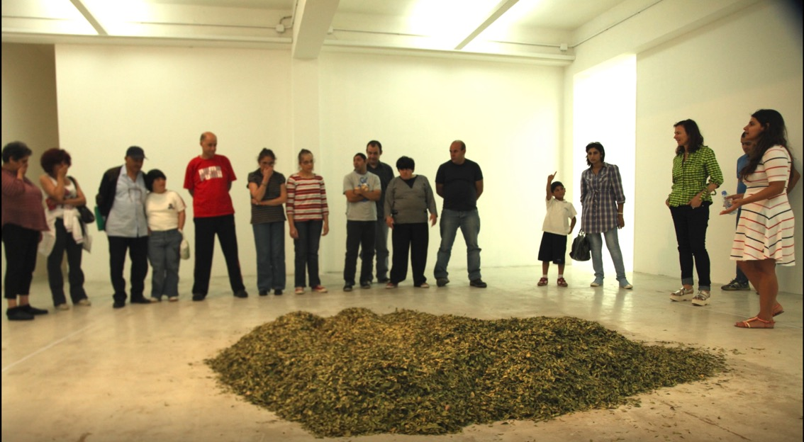
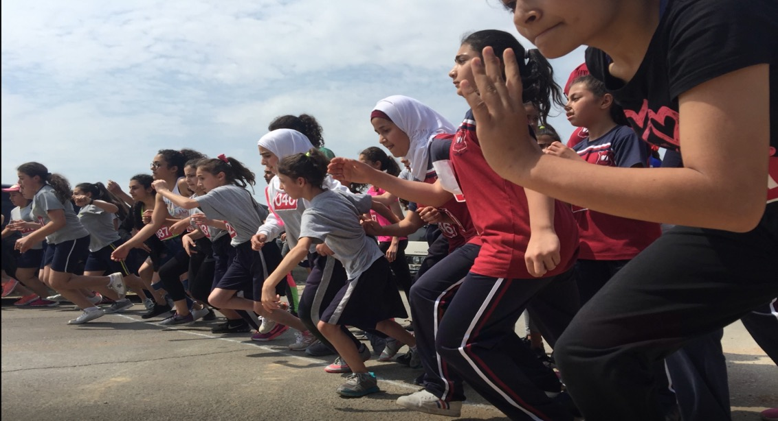
Art Practices, Inclusion, Visibility, and Disability
Cultural Institutions as spaces for producing inclusive, community based projects
Institution: Al Amal (Hope Institute) – Artist: Mounira Al Solh Project Location: Broummana – Lebanon
Notes:
Institution: Al Amal (Hope Institute) – Artist: Mounira Al Solh Project: NA
Date: 1959 – ongoing Further information: Video still Location: Broummana – Lebanon
Overview:
The internationally acclaimed artist Mounira Al Solh supports and works with the Al Amal Institute, created by her grandmother (the late Mounira El Solh), in Lebanon. Inaugurated in 1959, it was one of the first in the region to host people with disabilities and create a school for them. It became a successful school with about 150 students with special needs, who arrived from all over the Arab world. Having survived the Lebanese Civil War, today Al Amal functions as a family house for about 30 permanent residents with disabilities, all of whom live there and consider it their home, according to the artist, rather than a school. In the 1990s, the Institute launched programs to allow people with disabilities to work and attain employment. There is also a program to work with farmers with disabilities from Lebanon that was initiated by Al Solh’s father, Nassib el Solh. The Wheat and the Sweater programs allow people with disabilities to rely on themselves, be productive, and to grow crops. Their produce is produced to fair-trade standards and distributed in winter to impoverished people, refugees, people in jails, and those caught in zones of conflict in Lebanon

Slide 7
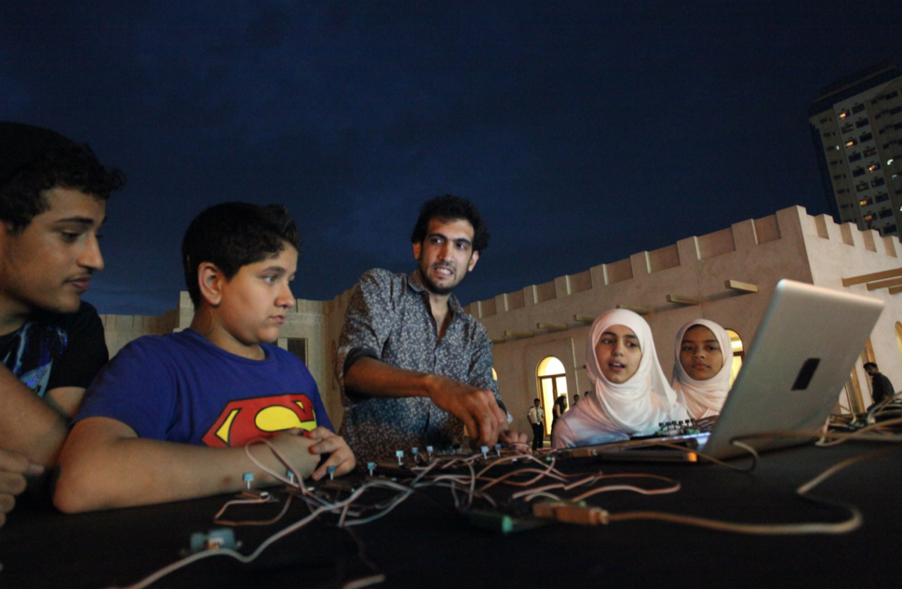
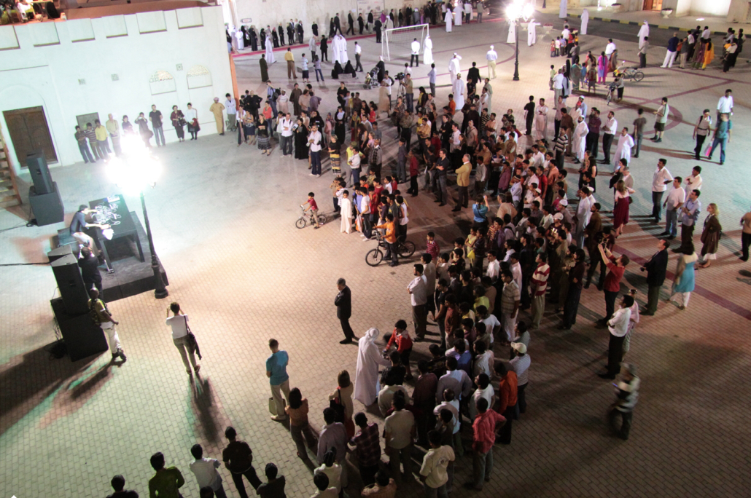
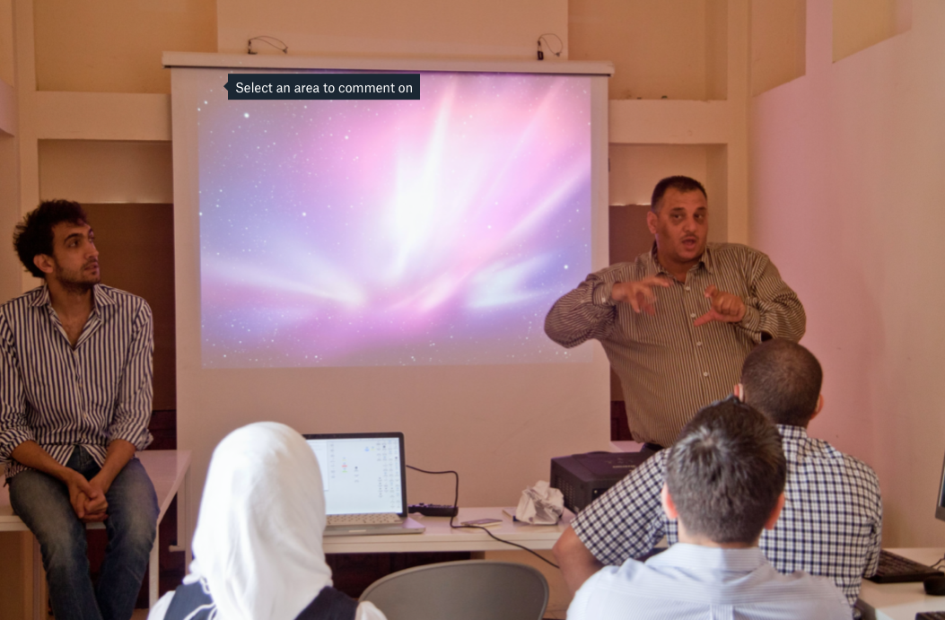
Art Practices, Inclusion, Visibility, and Disability
Cultural practice as a means to generate immersive spaces for co-design and production of projects
Tarek Atoui, Below 160, 2012
In collaboration with the Al Amal School for the Deaf in Sharjah
Performance still from the Arts Area, Sharjah
Notes:
How would you describe the sound of a marching drum to a person who will never be able to hear it? What does a bass riff look like? Does sound have a shape?
All these questions have been at the heart of a workshop taking place over the last week at the Al Amal School for the Deaf in Sharjah. Lebanese sound artist Tarek Atoui has guided students through a course that asks them to interpret different frequencies of sound subjectively and using senses other than hearing.
The low frequencies - below 160 hertz - meant that the non-hearing students are able to feel the vibrations and changes as Atoui played each sound.
On Friday, Atoui will present the fruits of this collaboration in the Heart of Sharjah district, incorporating instruments created by the students during the workshop and weaving it all together into a bass-driven composition. The programme is an initiative of the Sharjah Art Foundation.
Atoui is one of the region's key sound experimenters. In March, he performed his accumulated enquiries into the history of Arab music in the heritage district of Sharjah. But this latest project really questions the very nature of sound and the power it has to make us move.
How did you start working with deaf students on this project?
The idea came out of a performance I did in Salzburg last summer that used frequencies below 160 hertz (bass) - to create tactile sounds. I always had an audience of non-hearing people in mind when I performed this piece because they often develop a greater sensitivity to these frequencies.
SHARJAH: Bass sounds generated through vibrations could be used to transmit messages to individuals who are hearing-impaired as seen in a recent workshop. The workshop has proved that the capacity to feel and have a sensory experience in such individuals is much higher than those who have normal hearing. Tarek Atoui stated this in an exclusive interview with The Gulf Today on Friday. He was catching up ahead of the final presentation made by a group of 8 students from Al Amal School for the Deaf. The students are currently enrolled in Al Amal School, a part of Sharjah City for Humanitarian Services (SCHS). The group, aged between 12 and 22 years, had attended the 4-day long workshop organised by the Sharjah Art Foundation and conducted by Tarek. The students had learned and produced a variety of sounds with vibrations allowing them to use their imagination to display different effects in front of a large audience. Tarek has a degree in electro-acoustics from France and has been working on various projects to develop software that produces a low-frequency bass sound. The especially produced sound through Atoui’s software “Below 160” not only provides recreation to the general audience but also helps students with hearing disabilities to feel the sound effect through their bodies, transmitting various sensations. “Below 160”, the name of the software, literally describes the bass frequencies of below 160 Hz used to generate the effects. According to Tarek, the idea came to him during a performance he was giving in Austria last year. “During the performance, I was informed by a group in the audience that the hearing-impaired audience feels the music much more when compared to those with normal hearing. So, I worked on this idea to produce a unique bass sound and soon I started to develop a special software, ‘Below 160,’ to generate the sound with vibrations,” he added. In 2010, he was teaching students in SCHS and later in collaboration with Sharjah Art Foundation, the idea to work with a group of hearing-impaired students was approved and become the base for this 4-day workshop. “It was one of the most unique workshops held in the region for such students and they produced various projects that received great appreciation,” he added. “It was found that the nature of the sound with vibration — termed as bass and infra bass — greatly affects the bodies of individuals who are hearing-impaired, interpreting the effects as comparable to people with normal hearing. The students realised that these sounds transmit messages like compelling the body to calm down or feel fear,” he told. The students had made projects to produce effects seen on the surface of water filled in a bucket. A heavy-duty speaker was placed near the bucket which when put on generated patterns, allowing them to see sound effects through the vibration. Tarek is based in Paris where he got his degree in electro-acoustics 12-years ago and has since been conducting workshops and performing in front of eager audiences in various parts of the world. To a question, he said that the UAE has great potential for people ready to work in this field as local universities like the American University of Sharjah and organisations like the Sharjah City for Humanitarian Services are providing assistance in their capacities to their students. End

Slide 8
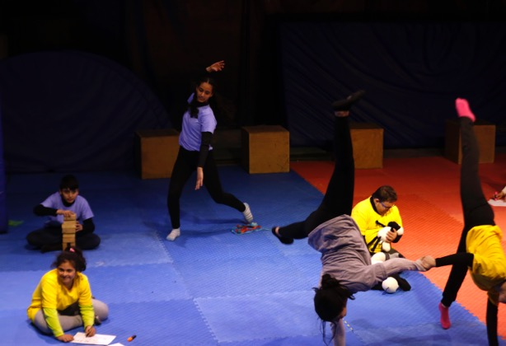
Art Practices, Inclusion, Visibility, and Disability
Culture as a means to develop public understanding of disability in contexts of conflict and crisis
Institution: Palestinian Circus School Project: Social Circus – Inclusion of people with disabilities
Date: 2016 – ongoing Further information: training – performance Location: Ramallah – West Bank
Image: The Magic of Circus Performance
Notes:
Institution: Palestinian Circus School Project: Social Circus – Inclusion of people with disabilities
Date: 2016 – ongoing Further information: training – performance Location: Ramallah – West Bank
Image: The Magic of Circus Performance
Overview:
The School started working on inclusion of people with disabilities in 2016, the process started by researching with local disability organizations on means and methods of integrating people with learning disabilities. The Circus School has been working for the past 4 years with 22 children with learning disability and down syndrome.
As a result of the training the School held an inclusive public performance entitled “The Magic of Circus”, where 10 children performed, five of whom with disability. This performance did not only affect the children with disabilities but also affected other children in the way they perceive disability. They have also held the first virtual international “Social Circus” conference in Palestine to promote equal rights and community inclusion in September 2020.

Slide 9
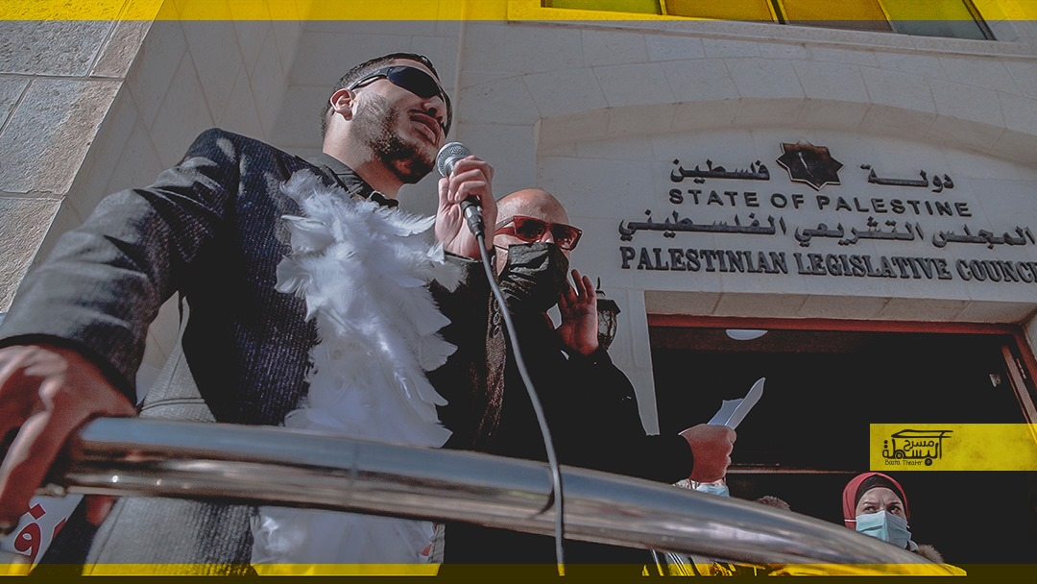
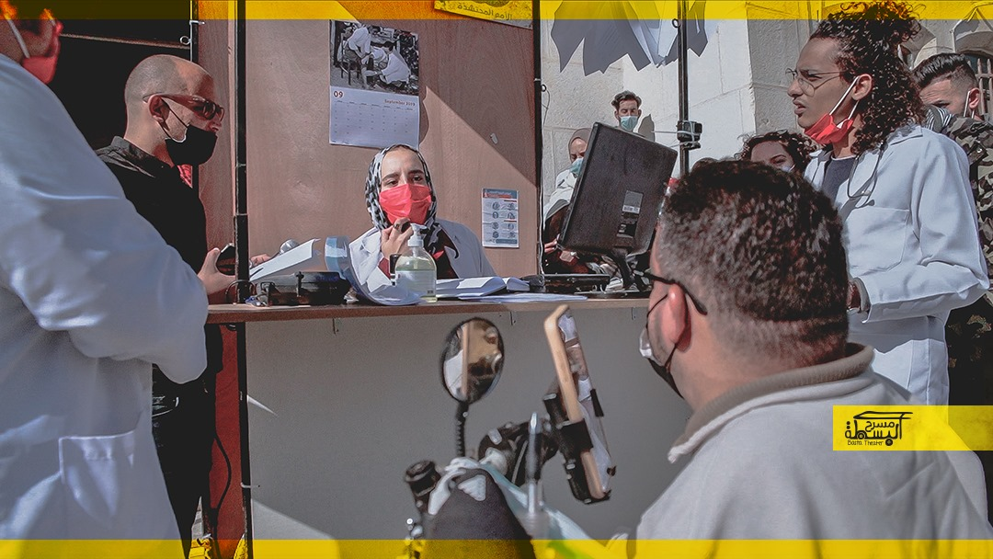
Art Practices, Inclusion, Visibility, and Disability
Support research and
evidence building to highlight priorities around disability inclusion in education
Collective: Basta Theatre Project: Insurance Basta
Date: December 2020 Further information: Video Performance still Location: Palestine - Ramallah – Legislative Council
Notes:
Collective: Basta Theatre Project: Insurance Basta
Date: December 2020 Further information: Video Performance still Location: Palestine - Ramallah – Legislative Council
Overview:
The work of the collective Basta Theatre combines both theatre and art activism. Working on artistic interventions in the community through performance art and theatre, it is an independent collective that started in 2015 in Jerusalem. Basta Theatre has recently collaborated with the Movement for a Better Life for People with Disabilities in Palestine, who have protested between October 2020 and January 2021 to have comprehensive, just, and free health insurance for persons with disabilities. Their demands were met on January 5th, 2021. The collective conducted a theatrical intervention and performance co-produced with the movement members entitled “Insurance Basta”, in December 2020, during which the actors included persons with disabilities demonstrating the struggles and injustice they face when seeking out health services.

Slide 10
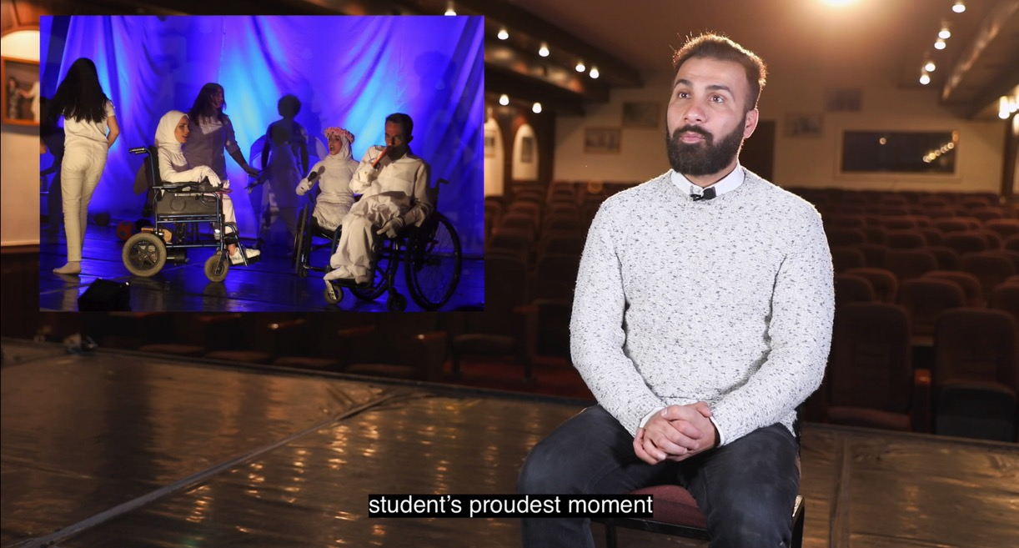
Art Practices, Inclusion, Visibility, and Disability
Enhance local, regional and international capacity to address issues of access, quality and participation
Artist: Murad Abu Saraya through Liwan Youth Space Project: Drama and Theatre training and performances for people with disabilities
Date: not indicated – ongoing Further information: video still Location: Jordan – Amman
Notes:
Artist: Murad Abusaraya through Liwan youth Space Project: Drama and Theatre training and performances for people with disabilities
Date: not indicated – ongoing Further information: video still Location: Jordan – Amman
Overview:
Murad Abusaraya is the director and coach for people with disabilities. He is a drama teacher and provides drama workshops and training for people with disabilities. Liwan youth Space is a safe and supportive space for groups, initiatives, and young activists to take an active role in the process of change. Liwan services target the age group 15-35 years by providing a place where young men and women interact to develop their ideas, initiatives and roles to influence the public life.

Slide 11
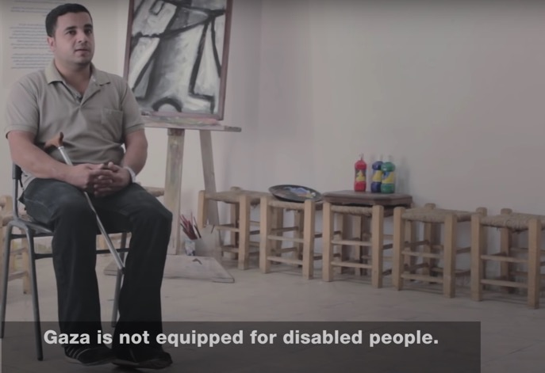
Art Practices, Inclusion, Visibility, and Disability
Diversity of
Media
Artist: Ramzi Maqdisi Project: Defying My Disability – Film
Date: 2016 Further information: Defying My Disability - Al Jazeera World - YouTube Location: Gaza Strip and West Bank
Notes:
Artist: Ramzi Maqdisi Project: Defying My Disability – Film
Date: 2016 Further information: Defying My Disability - Al Jazeera World - YouTube Location: Gaza Strip and West Bank
Overview:
The films showcase the challenges of people with disability in the Gaza Strip and West Bank through the narration of seven disabled Palestinians between the ages of 7 and 28 with different disabilities.
Note: Images are screenshots from the film

Slide 12
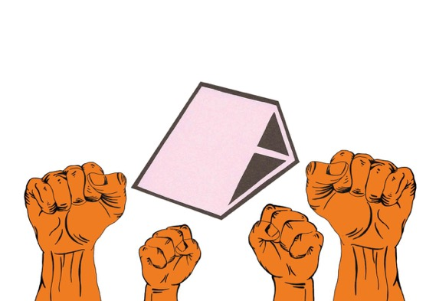
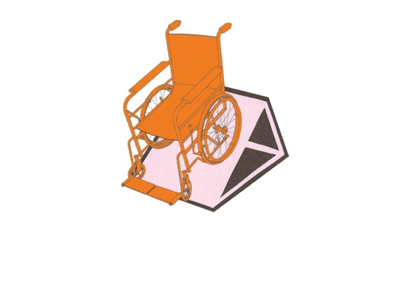
Art Practices, Inclusion, Visibility, and Disability
Diversity of
Media
Artist: Rusted Radishes Collective in collaboration with Beirut Moment Collective and Public Works (Lebanese Physically Handicapped Union)
Date: 2020 Further information: Digital Illustration- Disability Archetype
Notes:
Artist: Rusted Radishes Collective in collaboration with Beirut Moment Collective and Public Works (Lebanese Physically Handicapped Union)
Date: 2020 Further information: Digital Illustration- Disability Archetype
Overview:
Rusted Radishes Collective is an interdisciplinary Literary and Art Journal. One of the collective’s project was a digital illustration series called Object of Protest in collaboration with Beirut Moment Collective, another research collective based in London. The project was part of a partnership with Public Works, an architecture practice working within and towards public spaces, and the Lebanese Physically Handicapped Union, a grassroots advocacy organization for the handicapped. The proposed outcomes of Beirut Moments are self-built interventions focused on social impact, raising awareness and challenging perceptions regarding disability and its material culture. Furthermore, one of the poetry editors, Christine Choueiri has listed in her interests: gender, sexuality, queerness and disability (the mention of disability is not commonly listed in Lebanese artist’s statements of biographies).

Slide 13
Art Practices, Inclusion, Visibility, and Disability
Diversity of
Media
Artist/ Organization: Deaf Animation Team
Project: Animated Dictionary of Palestinian Sign Language
Notes:
Artist/ Organization: Deaf Animation Team in cooperation with Tamer Institute of Community Education / British Council and Palestinian Red Crescent Society’s Total Communication Project: Animated Dictionary of Palestinian Sign Language
Date: Not specified – Deaf Animation team project started in 2012 Further information: Learning animated video – screen shots from video Location: Ramallah – Palestine
Overview:
100 Signs is a project of the Deaf Animation Team in cooperation with the Tamer Institute of Community Education. It has three goals: to explore different ways of animating sign language, to create an engaging and attractive teaching resource for young learners, to develop a model for animated sign language resources that can be replicated by sign language communities in other countries.
The Animated Dictionary of Palestinian Sign Language was created as a reference as well as a learning resource for classes and home studies. Learning Sets from the dictionary were created for use in Sign Language Awareness classes. The classes are facilitated by the Deaf Animation Team. Their aim is to give members of the hearing community a basic understanding of sign language.
It's true that animation can really work wonders. I am not sure if you are interested in other examples at this point, but HI was involved in engaging an animation company in Gaza to support on awareness raising about the rights of all children to inclusive education, working with groups of children with and without disabilities who created the animations . https://www.youtube.com/watch?v=Xyisja80uY0&list=PLNfGGFaMkXSP21s5HW_4MGB73dlUQ2Tz7
https://www.youtube.com/watch?v=N8YBNd_zqkI
www.atfaluna.net

Slide 14
01 Legislation and Provision
02 Education, Cultural Networks and Disability
03 Effecting Inclusion Policy and Monitoring Progress
development of local, regional and international capacities
digital partnerships with disability advocates and organisations
communities of practice within cultural and disability organisations
interdisciplinary research methods for research-informed policy
Cultural Institutions:
Research and Educational Platforms

Slide 15
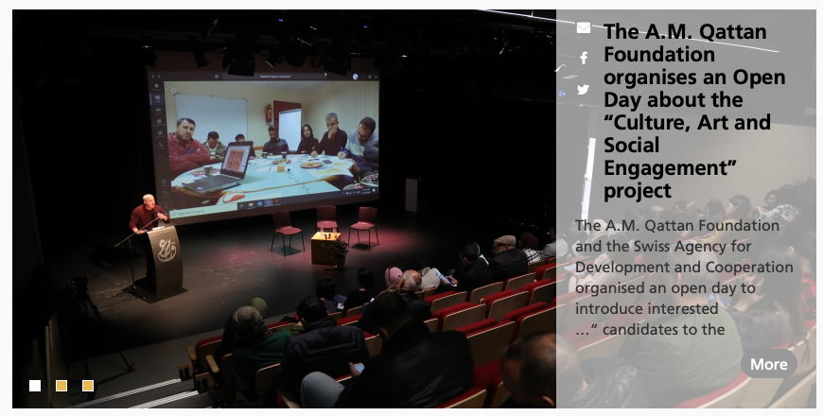
Cultural Institutions:
Research and Educational Platforms
Collaborations between cultural activities and disability organisations can encourage in person and digital partnerships with disability advocates and organisations
A.M. Qattan Foundation (Cultural Centre)
27 An-Nahda Women Association Street
Al-Tira- Ramallah, Palestine
Notes:
Living with disability in any part of the world comes with its own challenges - yet the main issue that the majority experience are societal attitudes, which seem to conspire to stop you from living an ordinary life. But what happens when you are not just fighting social prejudice, but also confronting a military occupation? This is precisely the battle that Mohamed Dalo from Gaza has been fighting since shortly after birth, when he was diagnosed with Muscular Dystrophy - the degeneration of the muscles - where almost every aspect of daily life is a struggle for survival and progression. From a very young age Mohamed was encouraged by his parents, particularly his father, to integrate fully - a lack of special needs schools made the decision a more natural one - and so he attended mainstream school and mixed with people of various abilities. This left Mohamed growing in confidence, as his fellow students and teachers gradually accepted his disability, and he became at ease with being "different" from others around him. The fact that Gaza has yet to acknowledge and implement the United Nations Convention on the Rights of Persons with Disabilities decreases the chance for personal development if you are an individual living with disability.
According to Medical Aid For Palestinians research, more than 87 percent of Palestinians with a disability are unemployed, and one third will never get married. More than one-third of Palestinians with a disability have never been to school, while many do not use public transport as it is not adapted sufficiently. It is these practical barriers which make living with a disability extremely hard under occupation. Yet Mohamed did not let these obstacles deter him from pursuing his dream of becoming an artist. Ever since he was a toddler, art was a hobby that grew into a passion which knew no barriers, when Mohamed's health and condition deteriorated and he could no longer endure the long and tiring school day, he had little choice but to leave education before he had the chance to complete his baccalaureate exams - the equivalent of British A-Levels - and so Mohamed embarked on a solitary journey to achieve his dream.

Slide 16
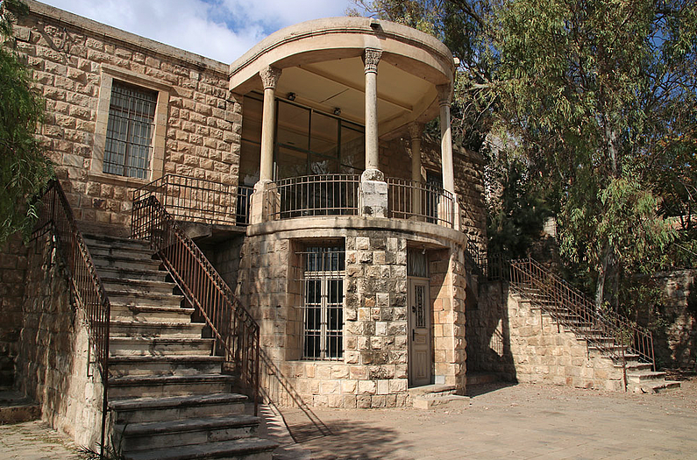
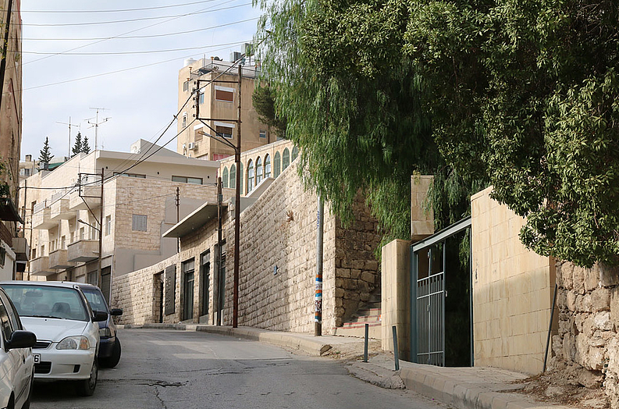
Cultural Institutions:
Research and Educational Platforms
the promotion of interdisciplinary research methods for research-informed policy and art and disability activist practices
Darat al Funun, Amman
Darat al Funun's main entrance, with The Lab in the background
Notes:
Founded in 1988 by Suha Shoman, Darat al Funun is a "home for the arts", and has become a meeting place for artists, a hub for artistic practices, experimentation and critical discourse, and an oasis for researchers and fellows.
Housed in six renovated historical buildings and warehouses, with a restored archaeological site in the garden, it creates a unique encounter between art, architecture, archaeology, and landscaping. For more information about the buildings and exhibition spaces, see the photo tour.
Darat al Funun holds and exhibits the Khalid Shoman Collection of contemporary art of the Arab world, organizes curated exhibitions, talks, film screenings, and educational programs; supports experimental projects at the Lab, hosts performances and concerts, offers a PhD fellowship and artist residencies, and publishes books and catalogues.

Slide 17
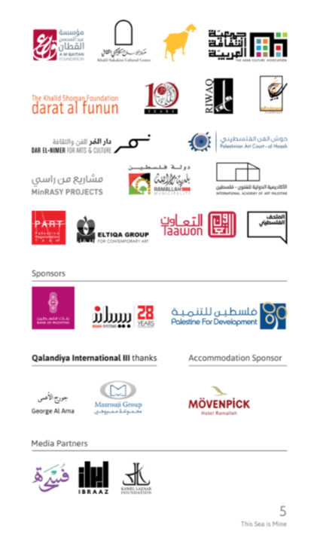
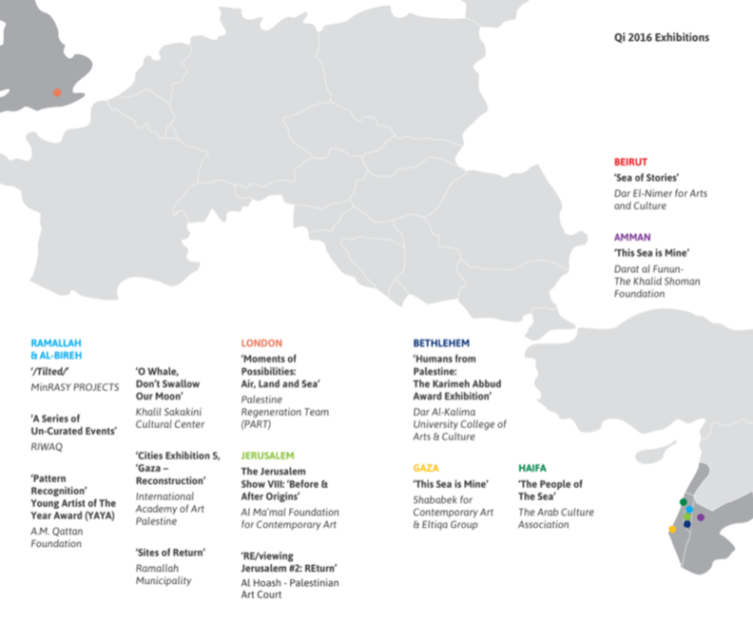
Cultural Institutions:
Research and Educational Platforms
the development of local, regional and international capacities to address issues of access in education for those with disabilities through digital methodologies
Qalandiya International, 2016

Slide 18
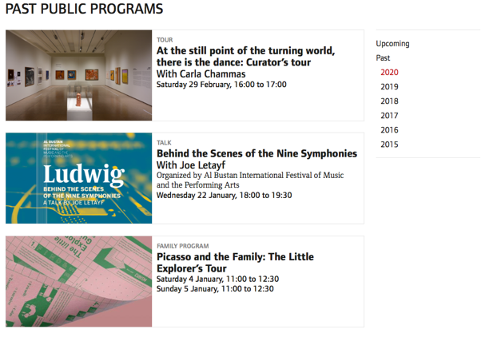
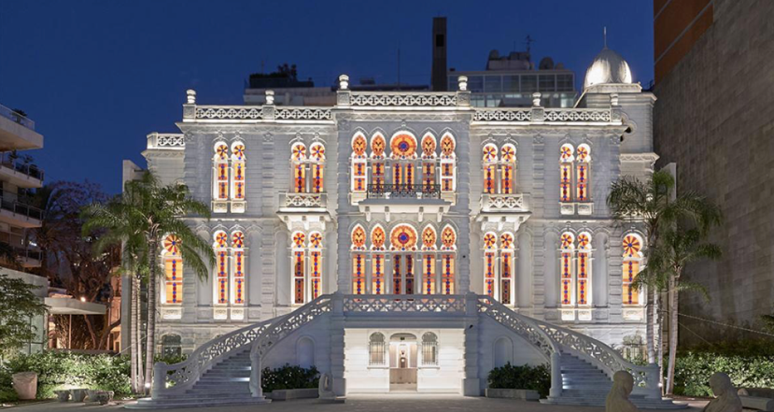
Cultural Institutions:
Research and Educational Platforms
the development of legacy programmes through developing communities of practice within cultural and disability organisations
Sursock Museum, public programmes
Sursock Museum, 2015
Sursock Museum, Baalbek, Archives of an Eternity
Notes:
Living with disability in any part of the world comes with its own challenges - yet the main issue that the majority experience are societal attitudes, which seem to conspire to stop you from living an ordinary life. But what happens when you are not just fighting social prejudice, but also confronting a military occupation? This is precisely the battle that Mohamed Dalo from Gaza has been fighting since shortly after birth, when he was diagnosed with Muscular Dystrophy - the degeneration of the muscles - where almost every aspect of daily life is a struggle for survival and progression. From a very young age Mohamed was encouraged by his parents, particularly his father, to integrate fully - a lack of special needs schools made the decision a more natural one - and so he attended mainstream school and mixed with people of various abilities. This left Mohamed growing in confidence, as his fellow students and teachers gradually accepted his disability, and he became at ease with being "different" from others around him. The fact that Gaza has yet to acknowledge and implement the United Nations Convention on the Rights of Persons with Disabilities decreases the chance for personal development if you are an individual living with disability.
According to Medical Aid For Palestinians research, more than 87 percent of Palestinians with a disability are unemployed, and one third will never get married. More than one-third of Palestinians with a disability have never been to school, while many do not use public transport as it is not adapted sufficiently. It is these practical barriers which make living with a disability extremely hard under occupation. Yet Mohamed did not let these obstacles deter him from pursuing his dream of becoming an artist. Ever since he was a toddler, art was a hobby that grew into a passion which knew no barriers, when Mohamed's health and condition deteriorated and he could no longer endure the long and tiring school day, he had little choice but to leave education before he had the chance to complete his baccalaureate exams - the equivalent of British A-Levels - and so Mohamed embarked on a solitary journey to achieve his dream.

Slide 19
Future Visions
Potential Cultural Outputs in Partnership with Disability Organisation
1. intellectual – the production of conference papers contributing to regional action through the formalisation of strategic development goals within arts institutions and other knowledge platforms in respect of disability and inclusion;
2. practical – preparation of new data sources disaggregated for knowledge production in the arts; preliminary development of national and school databases and training materials related to the arts and disability; and pedagogical initiatives and school knowledge exchange partnerships;
3. cultural – planning for future artist-led workshops; collaborative and participative events; exhibitions and narrative projects; film, video and performance events;
4. capacity – Enhance local, regional and international cultural capacity to address issues of access, quality and participation for those with disabilities in formal and non-formal educational settings

Slide 20
Disability Under Siege
Cultural Practices Literature Overview,
Findings and Future Visions
March 31st 2021
Professor Anthony Downey
Birmingham City University

