Slide 1
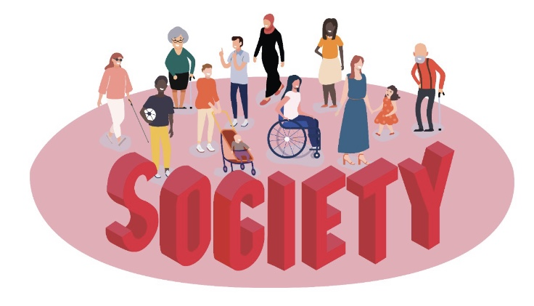
Words matter: Towards Inclusive Language
Dr. Itab Shuayb
Inclusive Design Specialist & Researcher at Centre for Lebanese Studies
itabshuayb@gmail.com
31 March 2021

Slide 2
Medical Model of Disability
The medical model of disability was first adopted by the World Health Organization (WHO) in the 1980s.
Defines disability in medical terms such as the blind, the handicapped, or mentally ill.
Legitimizes prejudice and discrimination against people with disabilities.
Implies special rehabilitation centers, special services, and special schools are provided.
Excludes people with disabilities from gaining equal and full access to mainstream education, employment, and services.

Slide 3
Medical Model of Disability
Describes a person as incapable of carrying out normal social activities because of an impairment or disability.
Uses the terms “We” and “them”, “people with disabilities” and “able-bodied”, “normal” and “abnormal”.
Emphasizes that people with disabilities are dependent, need help, and need a medical cure.

Slide 4
Social Model of Disability
The social model of disability was developed in the late 1970s by activists in the Union of the Physically Impaired Against Segregation (UPIAS).
Defines disability as something imposed on top of people’s impairments by the way attitudes and barriers limit their full participation in society.
States that society discriminates against people with disabilities and restricts them from accessing public and private services.
Legitimizes inclusion of people with disabilities by removing the attitudinal and physical barriers.
Includes inclusive policies and designs that provide equal access to all services.

Slide 5
Social Model of Disability
Describes disabilities as impairments that do not limit the carrying out normal social activities once barriers are removed.
Uses inclusive terms such as all people, with and without disabilities.
Emphasizes that people with disabilities can have full participation in society once services and built environments are designed inclusively.

Slide 6
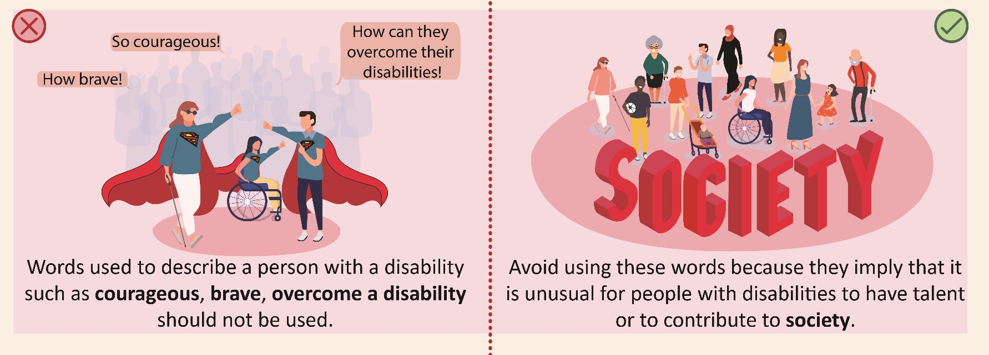
Word 1
Words used to describe a person with a disability such as courageous, brave, overcome a disability should not be used and should be replaced by
Avoid using these words as this implies that it is unusual for people with disabilities to have talents and the ability to contribute to society

Slide 7
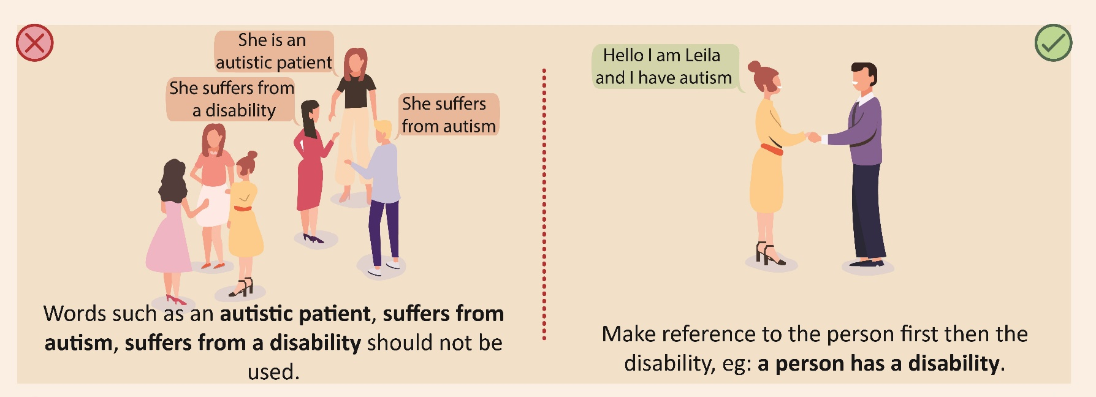
Word 2
Words such as an autistic patient, suffers from autism, suffers from disability should not be used
Make reference to the person first then the disability, e.g. A person has a disability

Slide 8
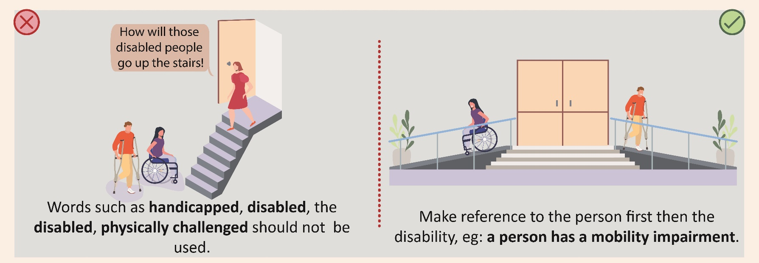
Word 3
Words such as handicapped, disabled, the disabled, physically challenged should not be used
Make reference to the person first then the disability, e.g. A person has a mobility impairment

Slide 9
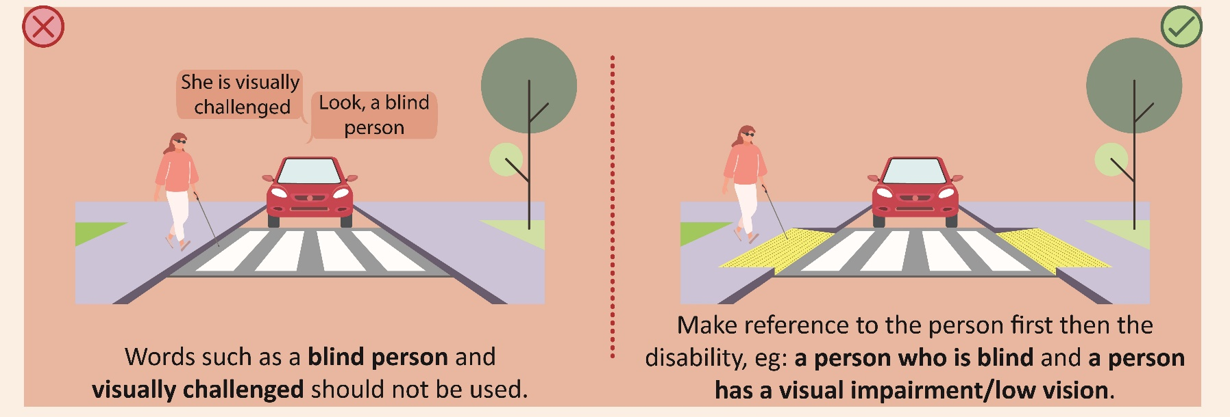
Word 4
Words such as the blind person and visually challenged should not be used
Make reference to the person first then the disability, eg: A person who is blind and A person has a visual impairment/ low vision

Slide 10
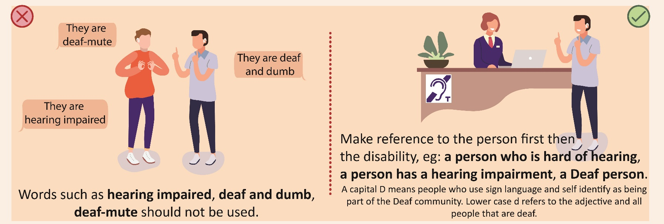
Word 5
Words such as Hearing impaired, deaf and dumb, deaf-mute should not be used
Make reference to the person first then the disability: A person who is hard of hearing, a person has a hearing impairment, A Deaf Person A capital D means people who use sign language and self-identify as being part of the Deaf community Lower case d refers to the adjective and all people that are deaf

Slide 11
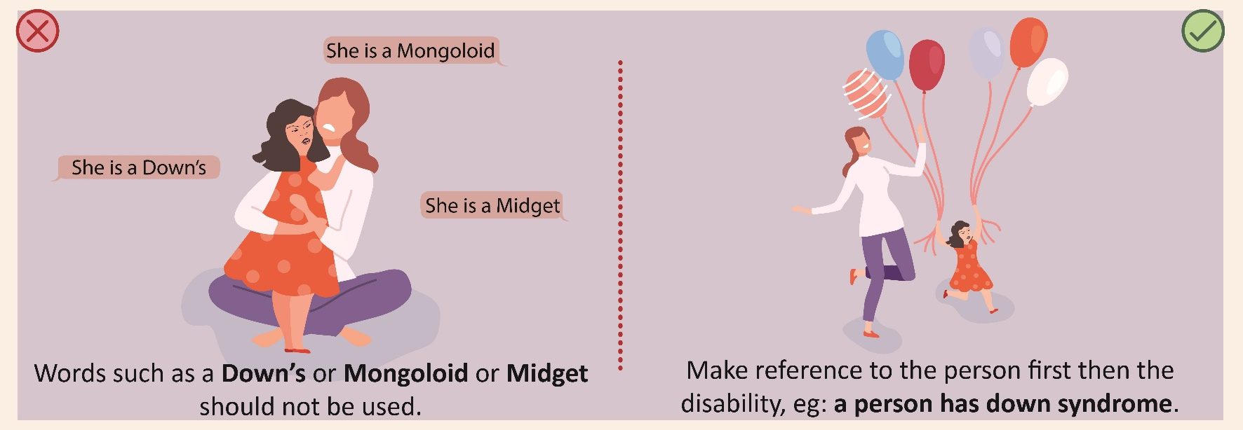
Word 6
Words such as A Down’s or Mongoloid or midget should not be used
Make reference to the person first then the disability: e.g.: A person has down syndrome

Slide 12
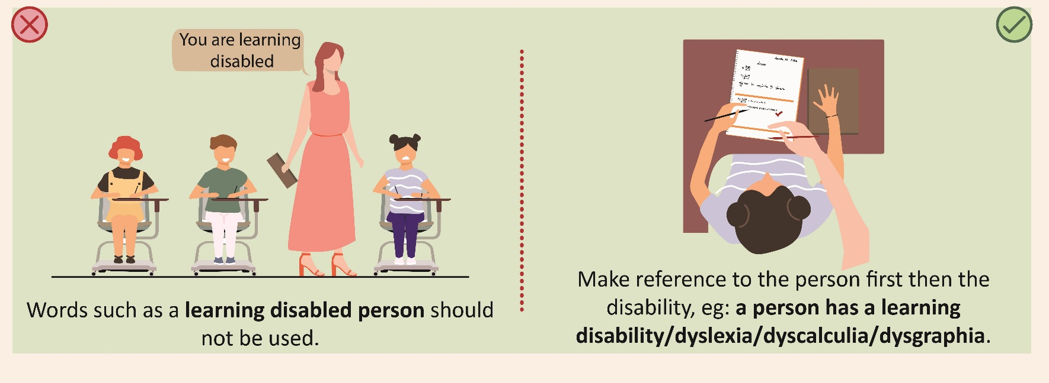
Word 7
Expressions such as a learning disabled person should not be used
Make reference to the person first then the disability. A person has a learning disability/ Dyslexia/ dyscalculia/ dysgraphia

Slide 13
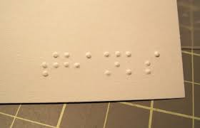
Dr. Itab Shuayb
Inclusive Design Specialist
itabshuayb@gmail.com
31 March 2021

